Slide 1
Bagging & Pasting

Slide 2
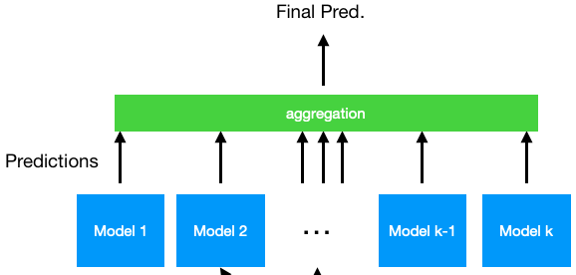
Bagging & Pasting
Remember: ensembles we want diverse classifiers to have no correlation between errors
1) Use different ML models
2) Train the same model on different data
Notes:
Photo: https://www.flickr.com/photos/107442568@N08/12547327134

Slide 3
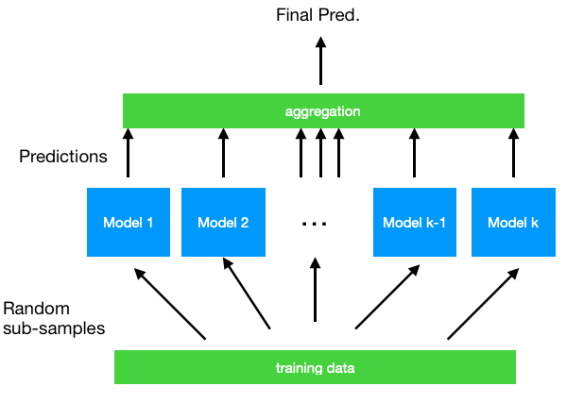
Bagging & Pasting
Bagging (bootstrap aggregation)
Random sampling with replacement
Notes:
Photo: https://www.flickr.com/photos/107442568@N08/12547327134

Slide 4
Bagging & Pasting
Bagging (bootstrap aggregation)
Random sampling with replacement
Pasting
Random sampling without replacement
Notes:
Photo: https://www.flickr.com/photos/107442568@N08/12547327134

Slide 5
Bagging & Pasting
Sample size of each training subset usually smaller than original
Each model has higher bias, lower variance, but aggregation of model predictions counteracts that
Model training is independent -> scalable through distribution
Notes:
Photo: https://www.flickr.com/photos/107442568@N08/12547327134

Slide 6
Bagging & Pasting
Can also randomly sample features, in addition to/instead of randomly observations
Bagging/pasting - randomly sampling observations
Random subspaces - randomly sampling just features
Random patches - randomly sampling both features and observations
Good for high dimensional data (lots of features)

Slide 7
Bagging & Pasting
Out-of-bag evaluation
Scoring each model against the samples that were not included in it’s training set
Allows us to estimate generalization performance without additional validation set
Not as good as cross-validation though

Slide 8
Extra Trees
Extremely randomized trees
When training an ensemble of decision trees, also randomize the thresholds (splitter=’random’), in addition to the training samples and feature subset to consider at each node
More bias, lower variance, more diverse models

